Slide 1
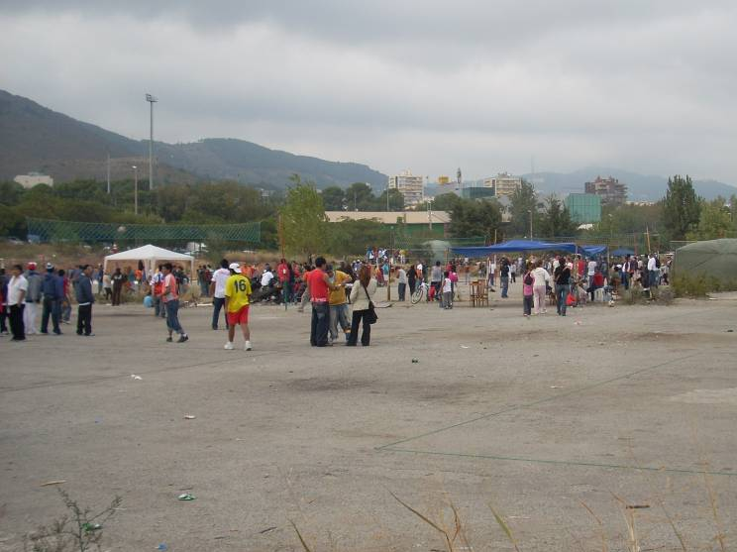
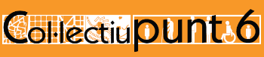
Cities for women, cities for all
Zaida Muxí Martínez, PhD in architecture
Marta Foneca, architect
colectivopunto6@gmail.com
http://punt6.wordpress.com/

Slide 2
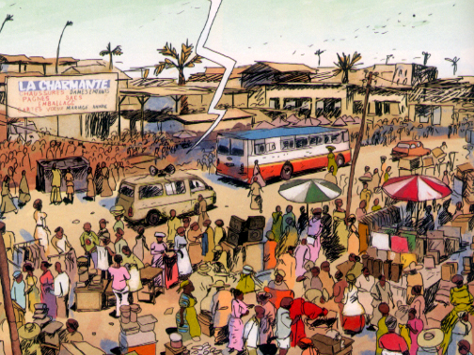
Why cities for women?
  Constructing Gender
  Gender in architecture and planning built?
  Applying gender perspective in planning
  Our experience: Col·lectiu Punt 6 - Catalunya

Slide 3
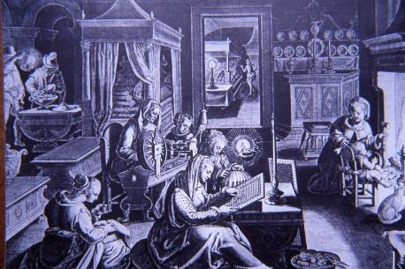
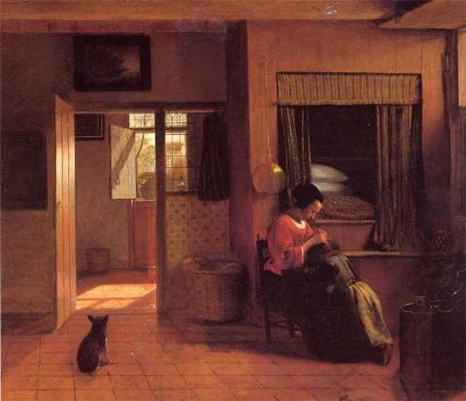
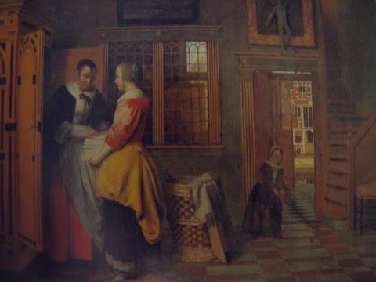
  Why Cities for women: Constructing Gender
Peter de Hooch:
A Mother and Child with Its Head in Her Lap
1629-1689 Armario de las lencerías 1663

Slide 4
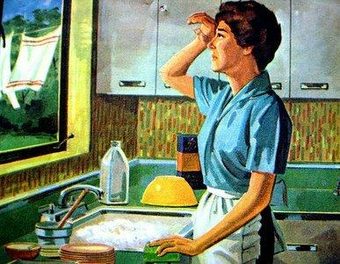
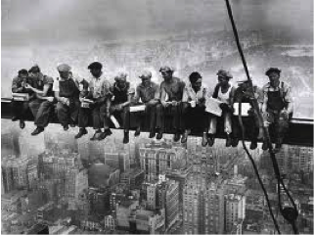
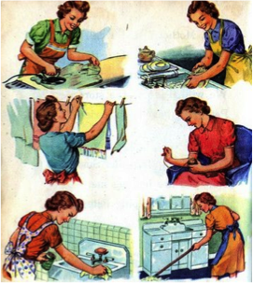
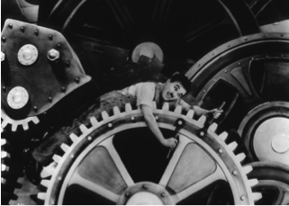
Construcció de rols de gènere
  Why Cities for women: Constructing Gender
Peter de Hooch:Tarea maternal 1629-1689 / SXVIII / SXIX
Anunci
Gender roles and space: public and private = men-women
Notes:
Western/US-Eurocentric research on urban planning and other sub-fields such as women’s safety in urban areas has accentuated the private-public divide of where violence happens, and when applied in non-Western contexts it has limited use. In particular, domestic violence and intimate partner violence is associated with the private sphere or the home. However, in places where “home” does not exist, the private/public bifurcation is inadequate for understanding violence against w omen. Paula Meth for example documents a case in South Africa with women living in informal settlements. She questions how safety can be measured when “home” does not exist because a person lives in a shack.
“Clearly women in these situations have less security to utilize as a defense against domestic violence. They cannot slam the door, lock someone out or secure the windows. These women live in public space, which has very few means of protection and has variable, complex boundaries”
While in the past decades a significant number of women have entered the paid workforce, this dualism continues to perpetuate domination and discrimination, and has limited the ability to attain gender equity. Planning must redefine traditional boundaries that separate the public and private spheres. This conceptual shift is a necessary prerequisite for effective gender planning. Planners must begin by acknowledging the diversity of spaces: public, private, semi-private, etc. Or instead of using the words “public” or “private”, we can talk about everyday life spaces or spaces of proximity, which are more inclusive concepts.
The private-public divide has also created hierarchies. In our society those activities related with the public and productive sphere continues to have a higher value than those activities related to the private and reproductive sphere, to the domestic and care work. In other words, the public-private divide has created a hierarchy between the paid and unpaid work. Therefore, our everyday life activities usually are considered in second term. The construction of cities and towns focusing prioritizing the public sphere complicates how people, and in particular women, since women continue being the responsible for the domestic and care work.

Slide 5
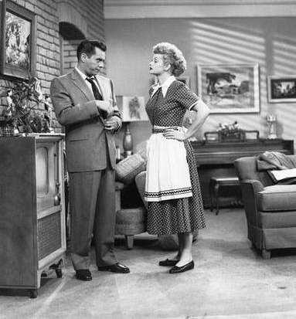
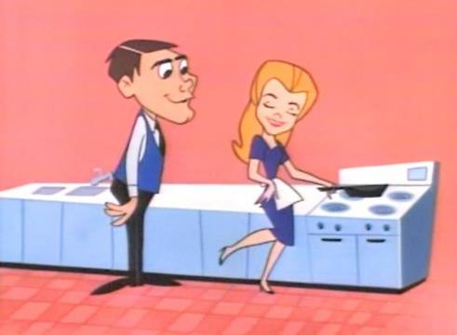

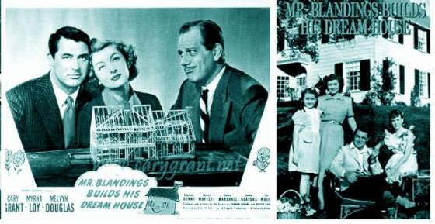
  Why Cities for women: Constructing Gender
Television and film role in the re-creation of women place

Slide 6
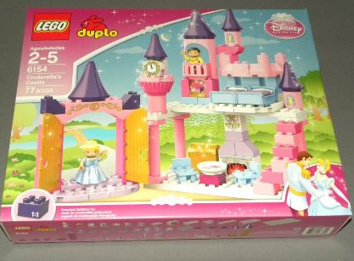
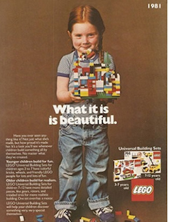
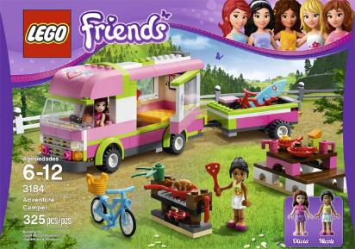
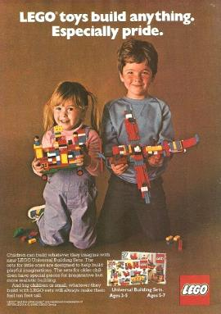
  Why Cities for women: Constructing Gender
2013 - 1981

Slide 7


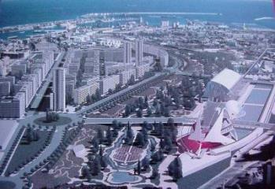
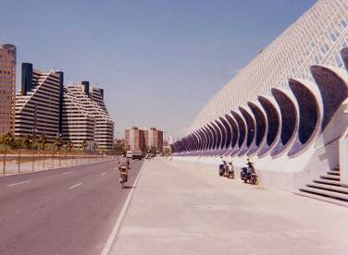
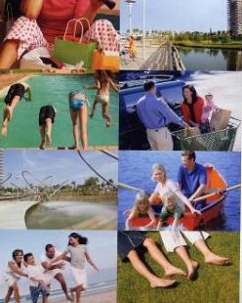
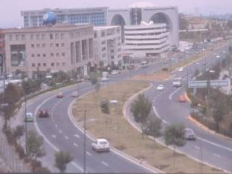
  Why Cities for women: Constructing Gender
How and where everyday life develops? What model of city is projected?
How do we live? Is this home? Is this neighborhood?

Slide 8
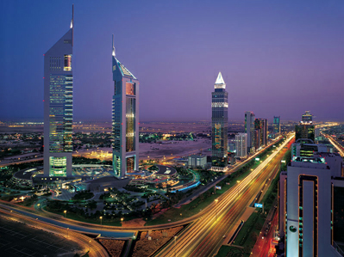
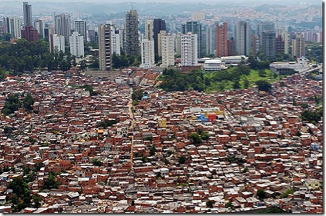
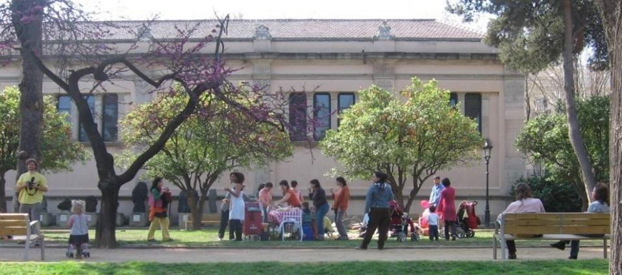
  Why Cities for women: Constructing Gender
Urban planning is not neutral Neutral and universal planning does not exist. What this neutrality does is to ignore the diversity in our society related with gender, origin, social class, ethnitcity, religion, sexual orientation, etc
Notes:
Urban planning from a gender perspective challenges the statement and general fostered in the field: “Urban planning has to be neutral”
Although we have heard many times that urban planning has to be neutral and universal, planning has not been inclusive because it has ignored in its design the everyday life, women and their activities. Thus, this “neutrality” has been fostered by an androcentric view; neutrality and universal solutions do not exist, but this discourse has favored a small part of society, “White male, middle class, middle age, employed and with full physical and mental capacities”

Slide 9
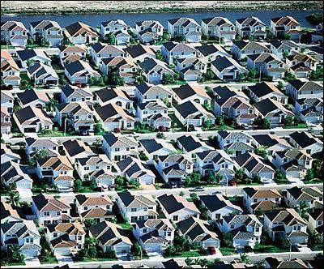
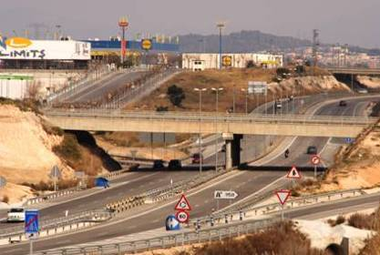
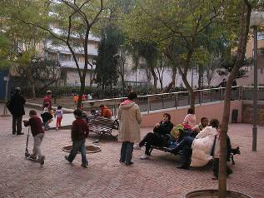
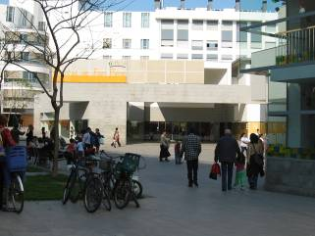

  Why Cities for women: Constructing Gender
Functionalist and segregated city
(city designed from the maps)
Vs
Compact city
(city designed from the everyday experience)
Notes:
9
Urban planning from a gender perspective takes as point of reference the experience of people who live and use the spaces analyzed. Taking the daily experience at the scale of community or neighborhood as point of analysis will help make recommendations at other scales: city, regional planning. Therefore, urban planning from a gender perspective values a model of compact city, that values everyday lives activities, fosters a sustainable mobility and social relations, while questioning the model functionalist city designed from the maps and that proposes segregated areas.
Challenge the functionalist and segregated city it is still more important in the context of developing or less-developed countries where resources are limited and basic needs are not always meet. If in these contexts we do not consider and include everyday life people’s needs, responsibilities and experience, urban areas will continue excluding a large of the population from having the right to the city.

Slide 10

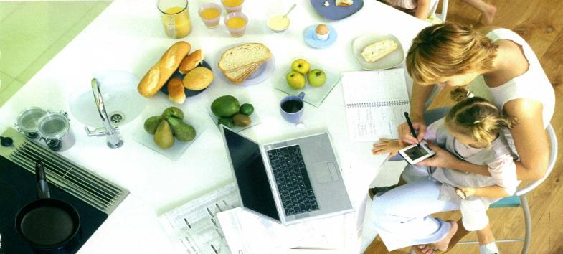
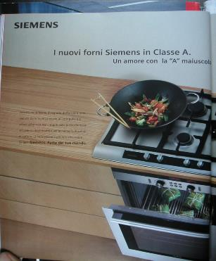
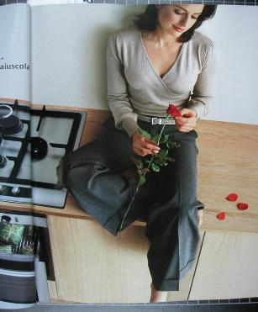
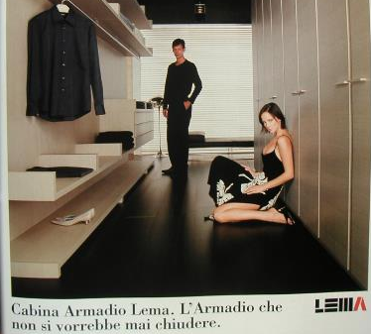
  How is the gendered profession in architecture and planning built?
N O W A D A Y S

Slide 11
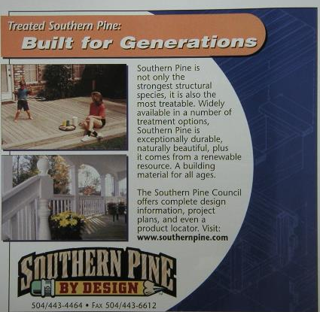
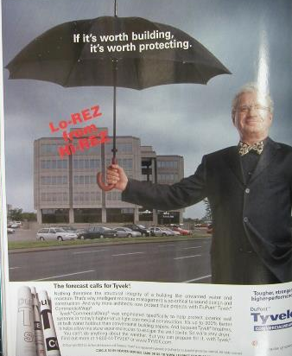
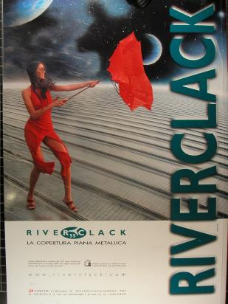
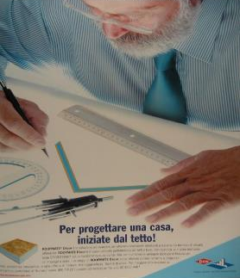
How are men and women represented in architectural magazines?
Men give security on work responsabilities
Women give security looking after the children
  How is the gendered profession in architecture and planning built?
Architectural Record October 2003 / L’Arca nº 185 2003/ Casabella nº 714 2003

Slide 12
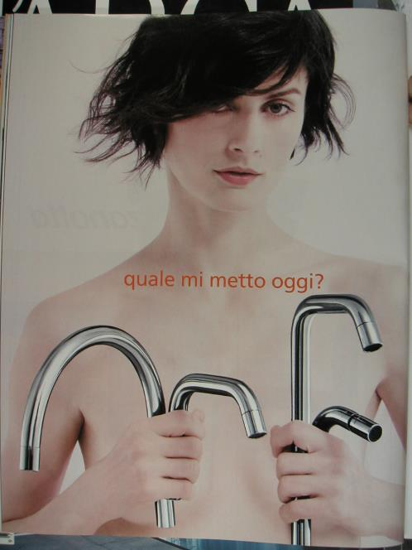
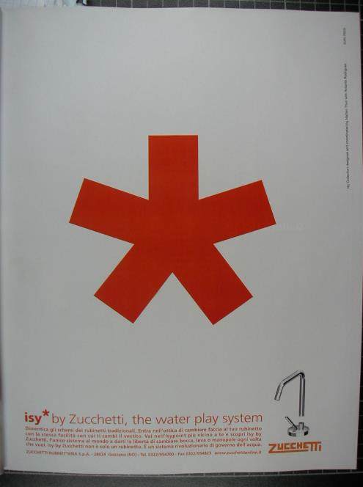
(which one do I wear today?)
No comments
  How is the gendered profession in architecture and planning built?
Revista Abitare
nº 432 año 2003

Slide 13
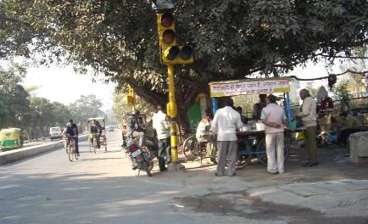
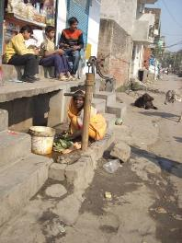
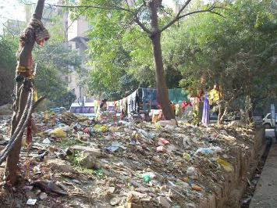
  Applying gender perspective in planning
Women’s experiences from everyday life in cities are knowledge for planning;
Unequal responsibilities between men and women, force women to use the city created only from the male upper-class planners experiences and needs;
Lack of attention or recognition from goverments and society to the multiple work women do deprive women to use of the city;
Unequal opportunities or rights to access to economical resources;
work women do , inside and outside the house , should be quantified and added to GDP.
The way the city had been shaped condition the women for a limited use of spaces within city, further depriving her of economic opportunities

Slide 14
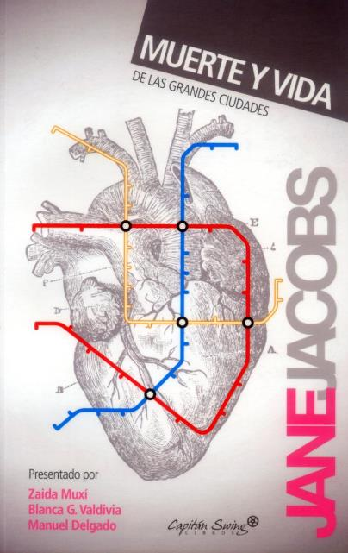
  Experiences applying gender perspective
“ This book is an attack on current city planning and rebuilding. It is also, and mostly, an attempt to introduce new principles of city planning and rebuilding, different and even opposite from those now tought in everything from schools of architecture and planning to the Sunday supplements and women’s magazines… It is an attack, rather, on the principles and aims that have shaped modern, ortodox city planning and rebuilding… I shall be mainly be writing about common, ordinary things..”

Slide 15
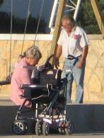
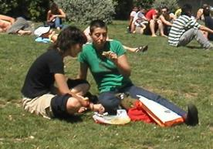
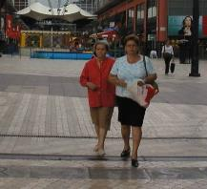
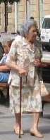
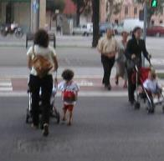
Ordinary things: what kind of city streets are safe and what kind are not; why some city parks are marvelous and others are vice traps and death traps; why some slums stay slums and others slums regenerate themselves even against finantial and official opposition; what make dowtowns shift their centers; what, if anything, is a city neighborhood; and what job, if any, neighborhoods in great cities do…
  Experiences applying gender perspective
HOW CITIES WORK IN THE REAL LIFE

Slide 16
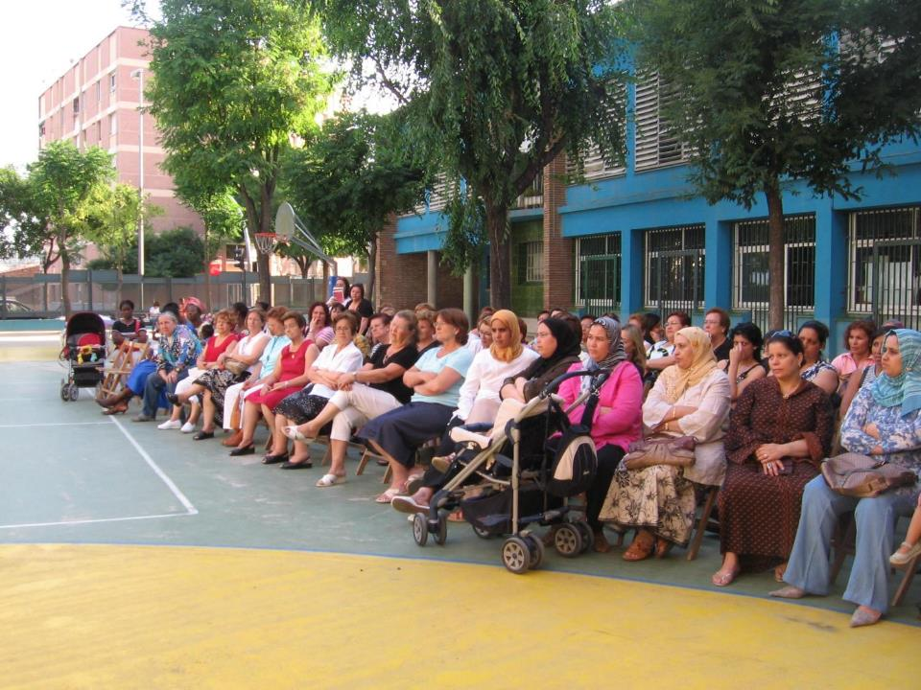
  Experiences applying gender perspective
Experiences from daily life

Slide 17
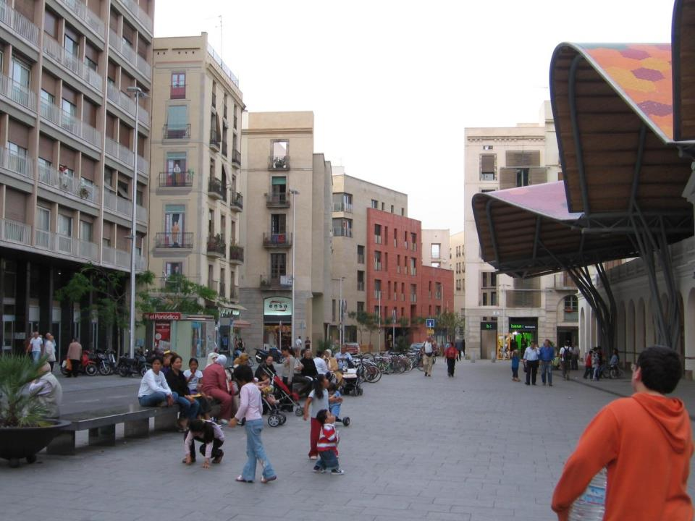
  Experiences applying gender perspective
The cities are complex systems

Slide 18
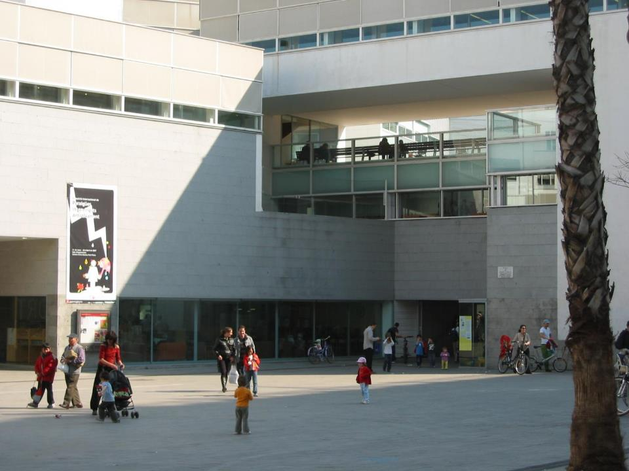
  Experiences applying gender perspective
Human being is the center

Slide 19




  Our experience: Col·lectiu Punt 6 - Catalunya
colectivopunto6@gmail.com punt6.wordpress.com
Notes:
I will start by who we are:
We are a diverse group of women architects, urban planners, and activists interested in rethinking cities, neighborhoods and architecture in order to eliminate gender discrimination. We work to build cities that reflect the diversity of our society by creating inclusive spaces.
Col·lectiu Punt 6 is an organization that works from a gender perspective, and seeks to account for women's everyday life experience. We use collective participation as an essential instrument in our projects
Our work is focused in different areas: we do training; research; participatory processes; cooperation, exchange and networking strategies with different women’s organizations at the local and international level; we offer consultancy services; and we do advocacy of women’s right to the city and women’s activism at the community and neighborhood level.

Slide 20

  Our experience: Col·lectiu Punt 6 - Catalunya
Research
Public participation
Teaching
Vindication
Gender Mainstreaming
Consulting
(& Designing)
Cooperation

Slide 21



  Our experience: Col·lectiu Punt 6 - Catalunya

Slide 22




Vindication
  Our experience: Col·lectiu Punt 6 - Catalunya

Slide 23





Vindication
  Our experience: Col·lectiu Punt 6 - Catalunya
Vindication: 1st Jane’s Walk Barcelona 2011

Slide 24






  Our experience: Col·lectiu Punt 6 - Catalunya
The city as living space, is a complex network of variables that come from learning about daily life in the inner city.

Slide 25


  Our experience: Col·lectiu Punt 6 - Catalunya
Check List: UDG / DUG
a way to introduce the gender perspective into the “normal” practice without the generation of an “against” possition

Slide 26






  Our experience: Col·lectiu Punt 6 - Catalunya

Slide 27



Slide 28


  Our experience: Col·lectiu Punt 6 - Catalunya
Can I participate in projects in the district where I live?
Tools used from the perspective of gender:
Maps sensitive (the Forbidden City and desired ...)
Chain shifts
Map of routes daily / daily
Walks of observation and visibility
Comparing employment land and / or places frequented by men / women, different ages ....
Workshops discussion (by subject and population groups)
Using statistical information as segregated
Others…
Public participation
Notes:
28
28

Slide 29










Institut Català de les Dones: Empowerment workshops(2005-2014)
Learning from Women’s experiences in the everyday environment
  Our experience: Col·lectiu Punt 6 - Catalunya
Public participation
Notes:
29

Slide 30





  Our experience: Col·lectiu Punt 6 - Catalunya

Slide 31



Designing public spaces
Propuesta “Generando vida cotidiana” para el Concurso Internacional de ideas para un entorno urbano con perspectiva de género organitzado por la Diputación de Cádiz. Marzo-abril 2011.

Slide 32


Designing urban elements
Propuesta “Generando vida cotidiana” para el Concurso Internacional de ideas para un entorno urbano con perspectiva de género organitzado por la Diputación de Cádiz. Marzo-abril 2011.

Slide 33






  Our experience: Col·lectiu Punt 6 - Catalunya

Slide 34


¿Cuál es el ámbito de nuestra vida cotidiana?
¿Cuáles dependencias de equipamientos y servicios?

Slide 35







Tiempo de desplazamiento entre equipamientos educativos
¿Espacio de relación?
¿De comunicación? ¿De información?
Con la comunidad educativa
¿Proponer un carril bici?
¿Poner en relación recursos?
¿Estancia urbana?
¿Franjas horarias de uso en tiempo estacional?
¿Aparcamiento de bicis?
¿Opción de movilidad para vincular redes educativas con otros servicios?
opciones de movilidad en relación a localización y uso de equipamientos y servicios

Slide 36


Slide 37







  Our experience: Col·lectiu Punt 6 - Catalunya

Slide 38


Recomendaciones para la implementación del Camino Escolar en la Escuela Margallò de Castelldefels, 2014

Slide 39




Slide 40





Slide 41

Diagnosis participativa para contribuir al proyecto de la c/ La Serra. Ullastrell, Barcelona. 2014

Slide 42







  Our experience: Col·lectiu Punt 6 - Catalunya

Slide 43


Capítulo “Construyendo entornos seguros desde la perspectiva de género” NO SURTIS SOLA. ICPS, Barcelona, 2011
La visibilidad: ver y ser vista. VISIBLE
La vigilancia informal y acceso a la ayuda. VIGILADO
La planificación y el mantenimiento de los lugares. EQUIPADO
La señalización: saber adónde se está y adónde se va. SEÑALIZADO
La participación de la comunidad. COMUNITARIO
La concurrencia de personas: oír y ser oído. VITAL
Michaud, Anne, 2002, Pour un environment urbain sécuritaire. Guide d’aménagement. Programme Femmes et Ville de la Ville de Montreal

Slide 44



  Our experience: Col·lectiu Punt 6 - Catalunya

Slide 45

Espacios Públicos. Trabajo de Cooperación en Cali, Colombia. Vivienda y Seguridad. En proceso 2015

Slide 46




Carolina Bernal Cárdenas. Taller CASA SIN GÉNERO. Máster Laboratorio Vivienda s.XXI, ETSAB 2005-13

Slide 47


Slide 48



  Our experience: Col·lectiu Punt 6 - Catalunya
Diagnosis-Everyday life Fátima and Carillo, Buenos Aires, 2012

Slide 49



Participatory women’s workshops Buenos Aires - UTIU 8 NORTE | SOLDATI Housing
  Our experience: Col·lectiu Punt 6 - Catalunya
Se sienten orgullosas de su trabajo, de cuidar su barrio
La iglesia no pareciera ser un sitio
importante para ellas por la poca
participación del cura en el barrio.
La escuela y la educación es importante para estas mujeres.
S32
S29
No les gusta que los comerciantes
No permitan el paso en vereda y que dejen sucio
Al centro de
Pompeya
S30
Usan el premetro para ir a Jumbo
Les gustan los espacios verdes para tomar mate, ir con chicos, espacios de sombra para sentarse
La placita del
Parque Roca es mencionada por varias mujeres
Inseguridad, droga y robos. Horario limite para moverse por la ciudad: 19hs. aprox

Slide 50



  Our experience: Col·lectiu Punt 6 - Catalunya
Creen que este terreno es
para viviendas de realojo V31
La canchita:
Pero faltan juegos
para chicos cerca
Les gusta su barrio porque es “abierto”, valoran los árboles.
Reconocen cuando algo está más “prolijo” y “arreglado”
La plaza es un espacio de relación importante para ellas. Valoran que exista aunque reconocen que hay sectores que no están en buen estado
Falta sombra en las
pérgolas
Plaza de la escuela:
les gusta aunque la
entrada de la escuela
es del otro lado
Les gusta mucho esta
plaza más que Fátima o
Carrillo. Distintas edades

Slide 51

  Our experience: Col·lectiu Punt 6 - Catalunya
3. RED COTIDIANA

Slide 52


Workshops in women's prisons:
Space of the prison according to the light of experience of women (Can Brians & Wad Ras)
  Our experience: Col·lectiu Punt 6 - Catalunya
Consulting

Slide 53



  Our experience: Col·lectiu Punt 6 - Catalunya
Workshops in women's prisons
Guided fantasy
Chain trips / tours
Spaces: reflections on practices and performances
Spaces "missing”
Agree conclusions
Consulting

Slide 54

  Our experience: Col·lectiu Punt 6 - Catalunya
... there is a convergence between the objectives of a social nature, with the kind of environment, as the city that best suits the perspective of women is a city of short distances and mixed uses, which, as has been demonstrated is more sustainable in ecological terms.
It is to build cities from the recognition of the role women play as enablers of everyday life on equal terms

Slide 55


Thank you very much for your attention!
colectivopunto6@gmail.com punt6.wordpress.com

