Slide 1


Slide 2
Fair-Shared City
Gender-sensitive Approach in Urban Planning in Vienna
Ass. Prof. Dr. Doris Damyanovic
Institute of Landscape Planning, Department of Landscape, Spatial and Infrastructures Sciences, BOKU, Vienna
Conference Women Friendly Cities
Ankara 10-11th of June, Turkey

Slide 3
Fair-shared Cities
Concepts to the right to a gendered city
(Fenster, T. 2005, Dufaux et al. 2008, Fainstein 2010))
Inhabitants have the right to “full and complete use” of urban space in their everyday lives
Inhabitants have the right to a fair participation in decision-making processes

Slide 4
What is necessary to turn a City (e.g. Vienna) into a fair-shared City?

Slide 5
Facts of Vienna
Capital of Austria
1.7 million inhabitants - 23 districts
increasing population after decades of stagnation
High percentage of historical districts
„Green city“, but lack of open space in districts close to the city center
Intensive public transport system (Modal Split, 39% public transport, 27% car traffic)
80% of new housing projects are subsidised

Slide 6
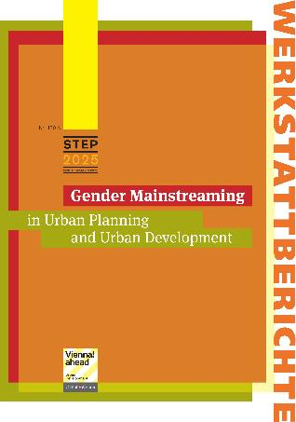
Vienna becomes a fair-shared City
20 years of experience
60 Pilot projects
Advising experts
Raising awareness of a higher number of planners, across all departments
Developing a manual with the a networked autonomous discourse apporach
(Böcher & Krott 2007)
DAMYANOVIC, D.; REINWALD, F. and WEIKMANN, A. (2013), Gender Mainstreaming in Urban Planning and Urban Development. Wien: Werkstattbericht der Stadt Wien.

Slide 7

20 Years Women´s Interests in the Field of Planning
1991: exhibition „Who does public space belong to – Women´s Everyday Life in the City “
1992: Women´s Office
1998: Co-Ordination Office for Planning and Construction geared to the Requirements of Daily Life and the Specific Needs of Women,
Co-Ordination Office puts focus on Gender Mainstreaming
2010: Restructuring of the Executive Office Group for Urban Planning, Development and Construction, Dissolution of the Coordination Office, Gender experts in the units: 1. Urban Planning Group, 2. Building Construction Group, 3. Public Works Group

Slide 8
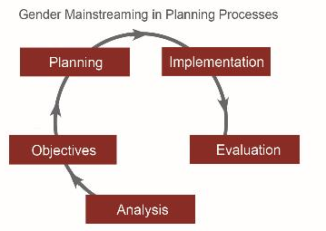
Planning for a fair-shared City
The underlying principles of the development of the manual
„Gender Mainstreaming in Urban Planning and Development“:
Process-orientated approach
Gender-sensitive perspective in all stages
of the urban planning process
Inter- and transdisciplinary
discourse

Slide 9
Planning for different life phases
- Everyday Life Perspective

Slide 10
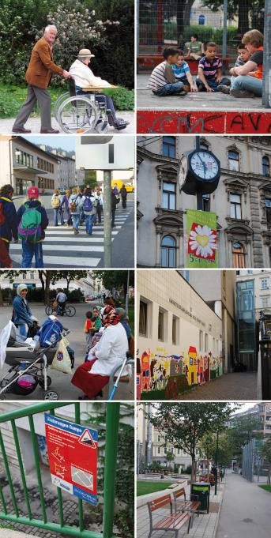
Everyday Life Perspective
The intensity of interrelations between persons und their local environments various according to life phases
Different user profiles give the visibility to the varying everyday realities of people in the urban context
The description of various groups permit deriving user profiles for planning and project development

Slide 11
User and user profiles
Children aged 6 or under
Children aged 6 to 12 years
Young people aged 13 to 17 years
Working-age women and men
Elderly or very aged women and men
Women and men with special needs
(

Slide 12
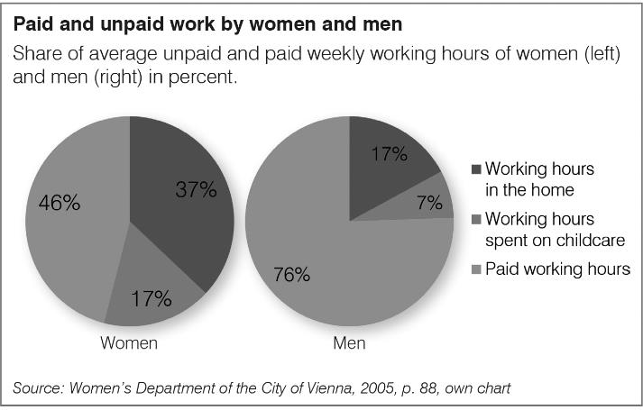
Gender distribution of paid and unpaid work

Slide 13
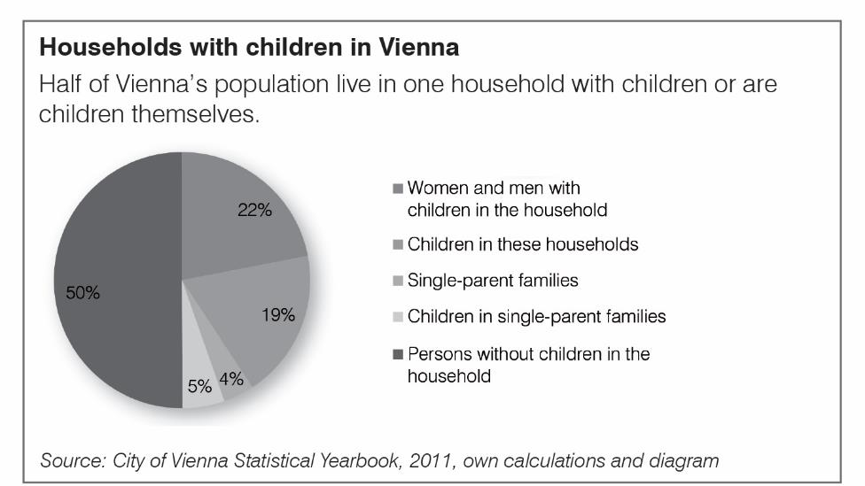
Households with children

Slide 14
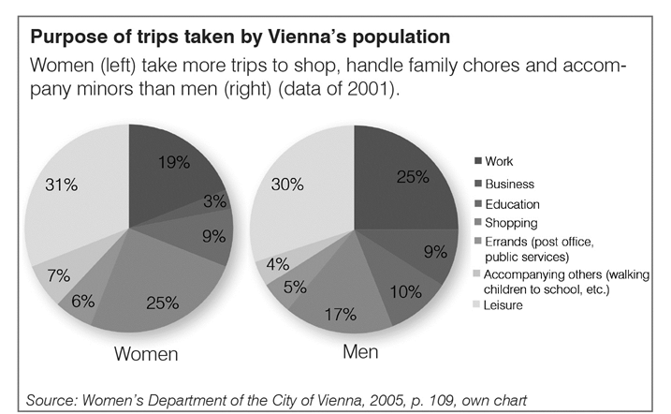
Purpose of trips taken

Slide 15
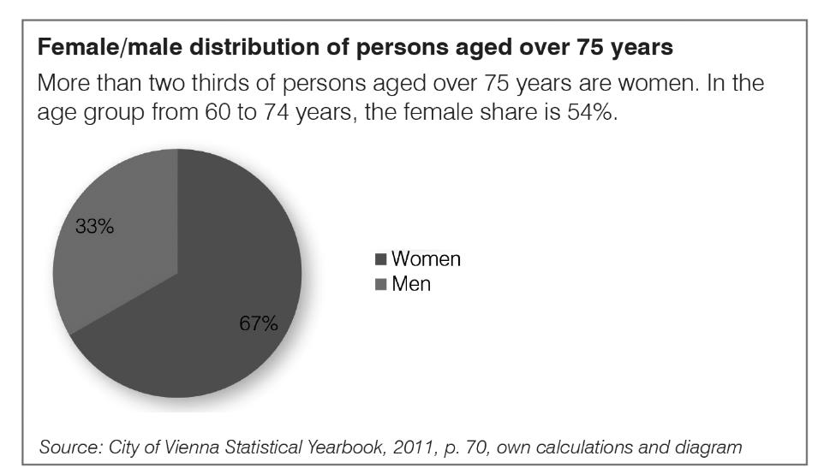
Female/Male distribution of persons 75+

Slide 16
Planning for different life phases
focuses on locally dependent groups:
Young people until 12 years
People who have to combine
family work and wage work
Elder people - 75+

Slide 17
Gender mainstreaming as a comprehensive planning strategy

Slide 18
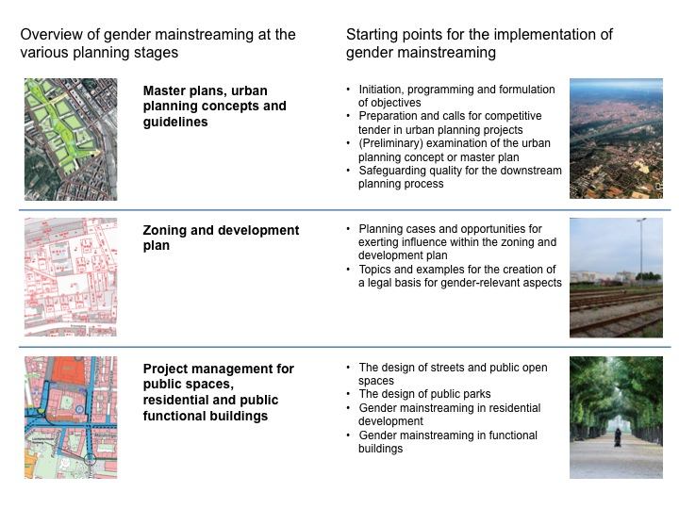

Slide 19
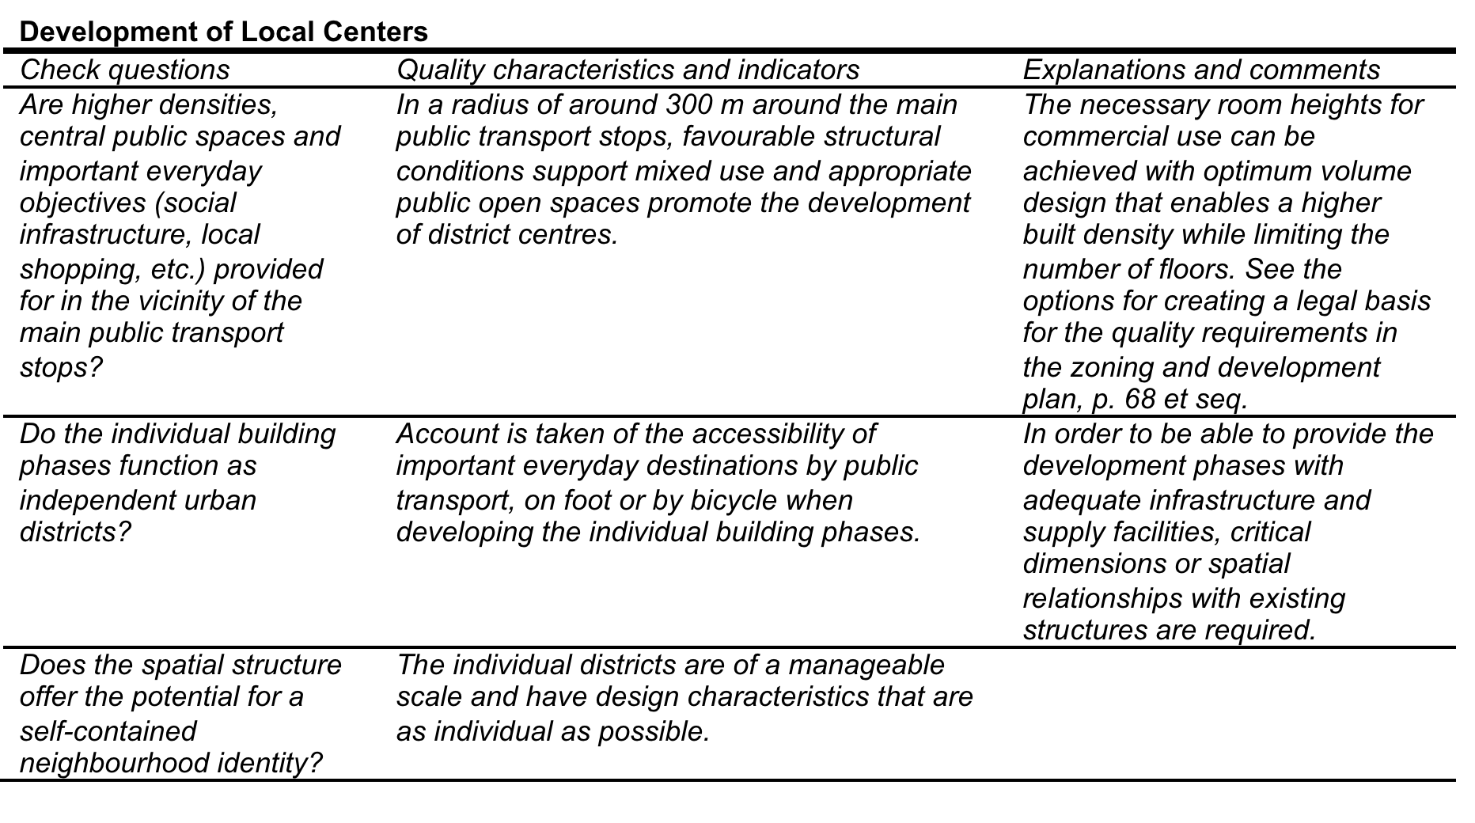
Formulating indicators for two main topics in urban planning:
City structures and Quality of living & Open space and Mobility
Check-questions
Quality criteria
Comments and
explanation

Slide 20
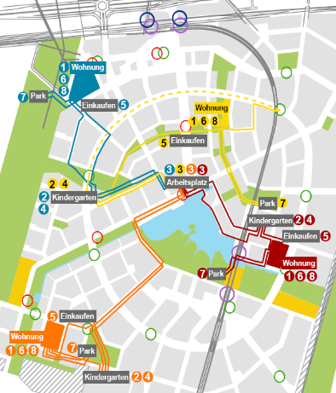
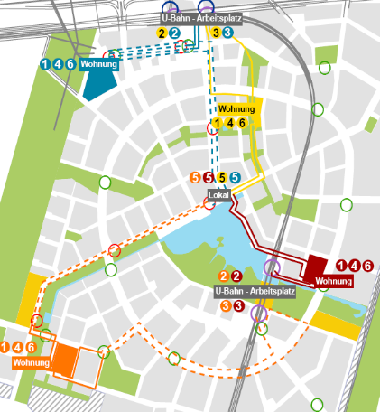
Everyday route check to evaluate the suitability of an master plan (f. e. Aspern)
Combination paid work and familiy duties
Paid work

Slide 21
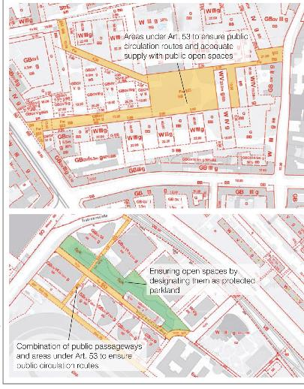
Gender-Sensitive Landuse Planning
Large-scale urban development projects
Significant upgrading of individual sites in developed areas
Structural additions or changes
Small-scale adaptation combined with area assessment and structure-improving measures

Slide 22
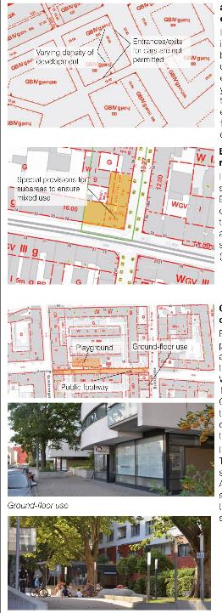
Gender-Sensitive Landuse
Planning
High-quality architectural und utilisation structures – (special designated areas special ground floor use)
Access und circulation quality and public space (parks and playground)
Social infrastructure (kindgarden, schools)

Slide 23
Gender Sensitive Park Design Criteria
Spatial structure (f. e. networking of open spaces, differentiated spatial concept)
Subjective feeling of safety/security
Activity range of girls
Recommended frame conditions

Slide 24
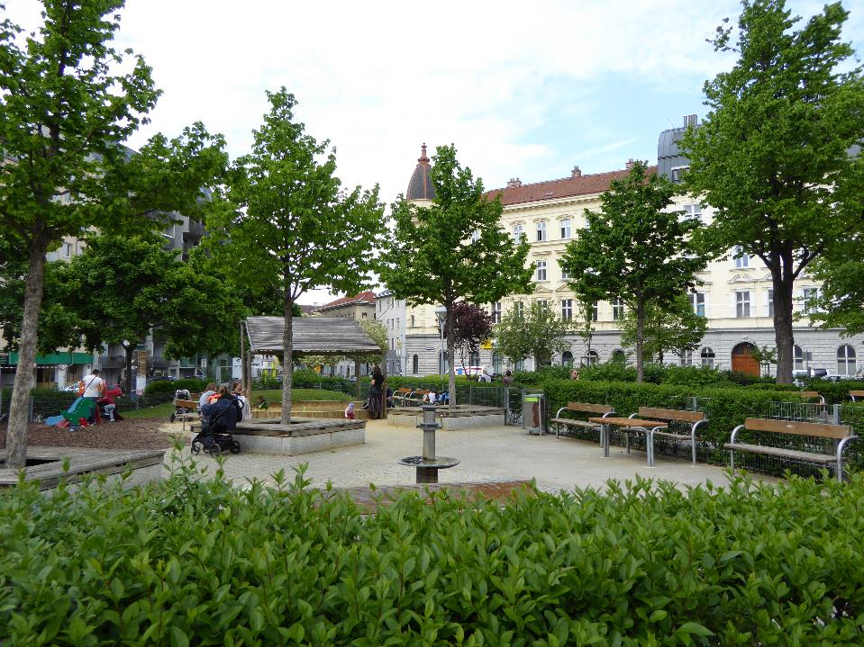

Slide 25
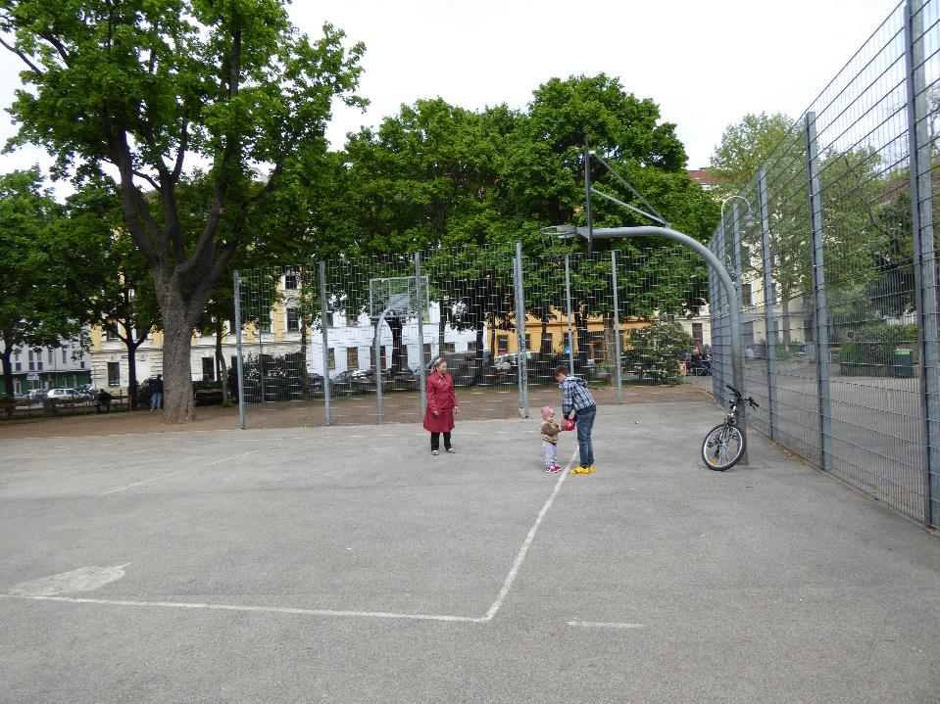

Slide 26
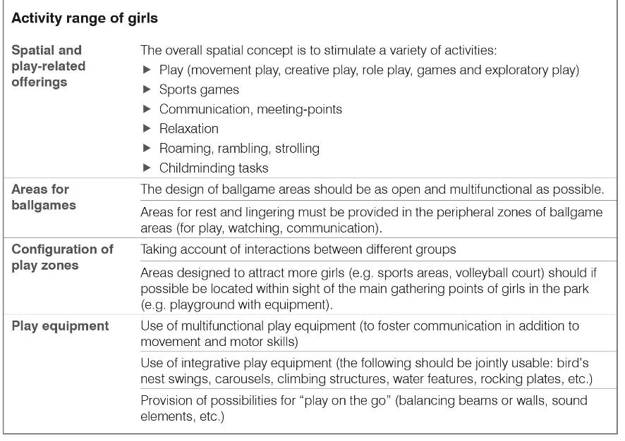

Slide 27
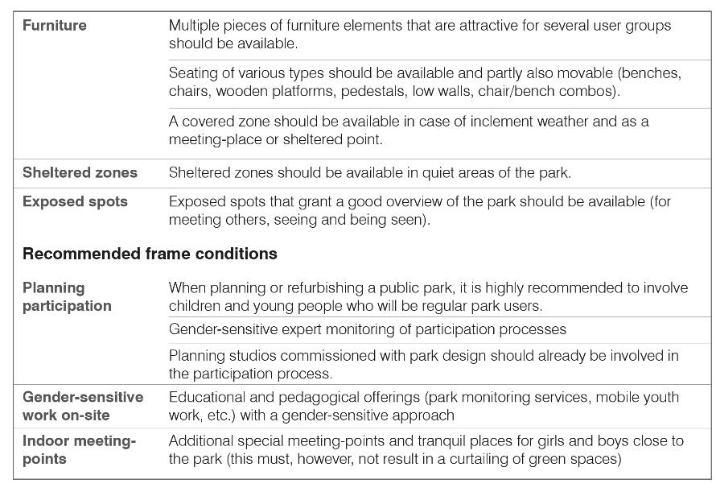

Slide 28
Gender-Sensitive Housing
Criteria
Size and Layout of Dwellings (f. e. attractive orientation, minimum size of rooms, natural lighting in kitchen)
Internal communication routes (f. e. manageable size of residential community)
Shared space/Communal rooms (f. e. attractive room, storage room for bikes and prams, attractive laundry room)
Open Spaces (private spaces, attractive space for toddler playground)

Slide 29
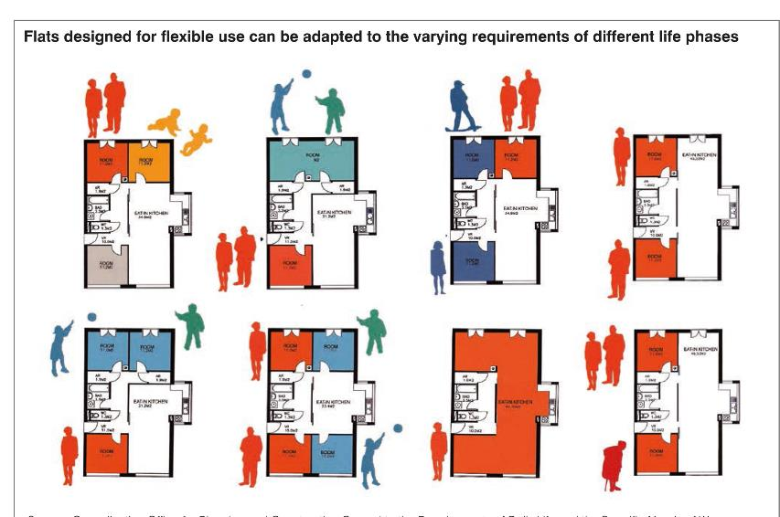
Concept flat designed for different life phases

Slide 30
Gender-Sensitive Housing
Objectives
Facilitating housework and family task
Promoting good-neighbourly contacts
Creating a housing environment where residents can move safely even at night
Providing the widest possible range of different flat layouts

Slide 31
Gender-Sensitive Housing
Objectives
Economical and flexible layouts offering options for women with lower incomes
Attractive range of private and semi-public open spaces
Good range of social infrastructure facilities
Promoting the work of women planners

Slide 32
Conclusions
Gender Mainstreaming is an political instrument to implement the concept of a fair-shared city/just city/women friendly city in concepts, policies and planning strategies
Vienna shows us that the planning approach of equity planning to implement the fair-shared city/women friendly concept is successful

Slide 33
References
DAMYANOVIC, D.; REINWALD, F. and WEIKMANN, A. (2013), Gender Mainstreaming in Urban Planning and Urban Development. Wien: Werkstattbericht der Stadt Wien.
https://www.wien.gv.at/.../studien/pdf/b008358.pdf
Dufaux, F., Lehmann-Frisch, S., Moreau, S., Gervais-Labony, P. (Eds.), 2008. Birth announcement. Paris: Self-published.
Fainstein, S., 2010. Just City. Itaca: Cornwall Press.
Fenster, T., 2005. The right to the Gendered City: Different formations of belonging in everyday life. Journal of Gender Studies, Vol. 14, No. 3 November: 217-231.

Slide 34

Contact
Ass. Prof. Dr. Doris Damyanovic
Institute of Landscape Planning
Department of Landscape, Spatial and Infrastructure Sciences
University of Natural Resources and Life Sciences, Vienna
Peter-Jordan Strasse 65
1180 Vienna
phone.: 0043/1/47654-7255
fax.: 0043/1/47654-7259
mobil: 0043/664/21 31 737
homepage:
www.rali.boku.ac.at/ilap.html
http://www.rali.boku.ac.at/ilap/gdus-network/
http://www.genderste.eu/
http://aktive-jugend.boku.ac.at

Slide 35



genderSTE
Science, Technology, Environment
A COST TARGETED POLICY-DRIVEN NETWORK

Slide 36
Chair INÉS SÁNCHEZ DE MADARIAGA Ministry of Economy and Competitiveness, Spain Vice-Chair MARCELA LINCOVA Czech Academy of Sciences, Czech Republic
genderSTE COST ACTION TN 1201 Start date: 28/11/2012 End date: 27/11/2016
A COST TARGETED POLICY-DRIVEN NETWORK

Slide 37
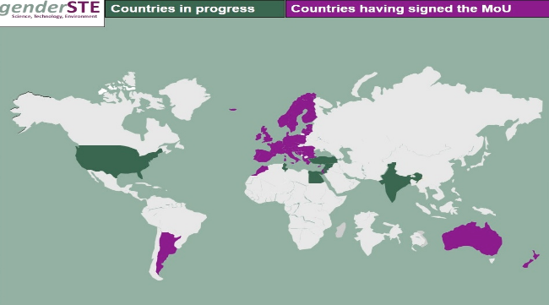



WHO AND WHAT IS genderSTE ?
genderSTE is a network of policy makers and experts committed to promoting a fairer representation of women and better integration of gender analysis in research and innovation. We disseminate state of the art know-how on structural change of institutions and on methods for gendered analysis in research. We aim at advancing the state of knowledge in the specific fields of: cities, transport, energy, climate and industrial innovation. Our members represent government bodies, research organizations, universities, non-profits, and private companies from 40 countries, in Europe and beyond, as well as international organizations.

Slide 38

EDITH STEIN TRAINING SCHOOL Engendering Research about Cities, Transport, Energy & Climate Change
2015, Istanbul, 2nd-6th of November
Target group: young researcher

Slide 39

www.genderSTE.eu
Design: Sofia Morgado, April 2014

