Slide 1
Thinking Ahead
Gender Mainstreaming
and the Roadmap towards Equality in Berlin
Dr. Gabriele Kämper
Head of Equality Office Berlin
Gender Mainstreaming at Local Level International Conference
Ankara 10.-11.6.2015

Slide 2

Agenda
Gender Equality Policy Framework Program (GEPF)
Core areas and factors for success
Mission Statement „Gender Equality in Berlin“
Aspects of a Women Friendly Berlin

Slide 3

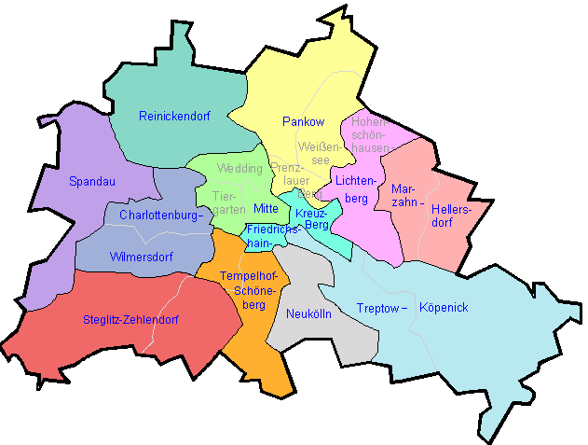
The State of Berlin
Area: 892 km²
12 boroughs
Inhabitants: 3,459,000 (end of 2010)
GDP: €94.7 billion (2010)
GDP per inhabitant: €27,400 (2010)
GDP growth (real) : 2.7% (2010)
Unemployment rate: 13,6% (May 2011)
Adjusted expenditure: €22.0 billion (2011)
Expenditure per inhabitant: €6,360
Balanced budget: yes (2007, 2008)
Debt: €60.4 billion (2010)
Debt per inhabitant: €17,460 (2010)
(State) Employees (FTE): approx. 106,000 (2011)
approx. 207,000 (1991)

Slide 4
Historical Lines
Women’s Rights
Gender Mainstreaming
Gender Budgeting
Gender Equality Policy Framework Program (GPR) I+II
A Mission Statement: Gender Equality in Berlin
Campain: Thinking Eqality Ahead
Notes:
The Berlin-wide Gender Equality Policy Framework Program (GPR) has been in operation since 2008. Under its umbrella, all bodies of the Berlin government have agreed on their gender equality responsibilities. Both Gender Mainstreaming and Gender Budgeting are components of the GPR’s agenda.
The concept is that gender equality should be addressed by mainstream policy, not a peripheral institution. Recognizing the critical role that money always plays, the drive for a gender-equitable distribution of funding is described using the term gender budgeting

Slide 5
Political Resolutions
2002 First Commitment to Gender Mainstreaming and Gender Budgeting
in Berlin‘s Parliament
2008 Resolution Gender Equality Policy Framework Program (GEPF) I
2014 Resolution Gender Equality Policy Framework Program (GEPF) II
Coalition Agreement 2006-2011
  „We want to make that gender equality has a crucial role in safeguarding social cohesion and future of Berlin ...“
Guidelines for the Berlin Government Policy 2011-2016
  „The Senate is firmly committed to ensuring the improvement of gender equality and equal opportunities for all genders in all sectors of society.“

Slide 6
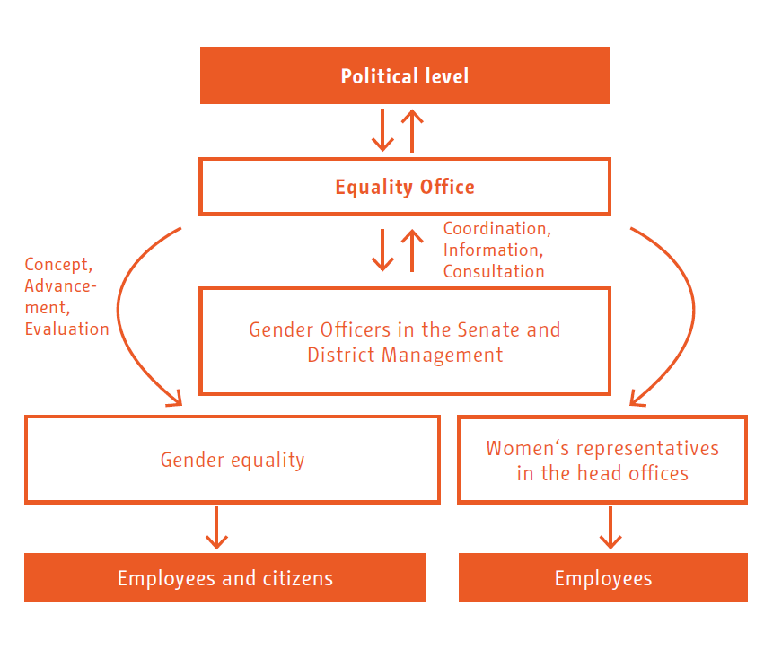

Slide 7
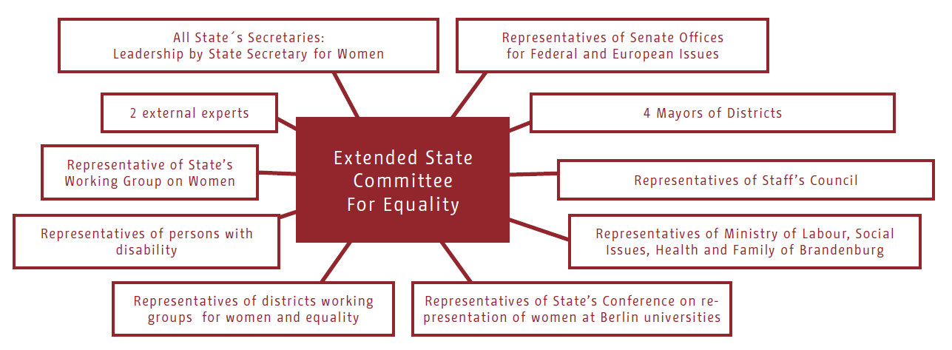

Slide 8
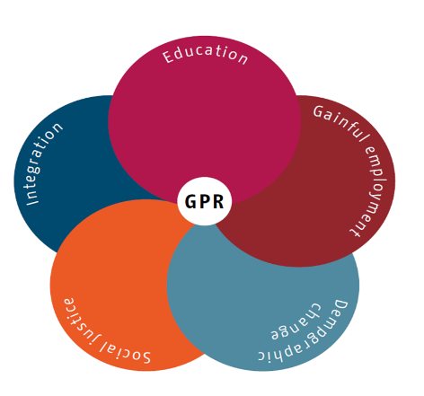
First Things First – 5 Core Focus Areas
Education
Sustainable Employment
Demographic Transition
Social Justice
Integration
Notes:
Which issues are the most crucial in order to advance equality between men and women? Which issues are already central in Berlin policy and thus currently on the table? In light of both these criteria, the GPR has determined its five core focus areas: education, sustainable employment, demographic transition, social justice, and integration.
Education
Education determines career opportunities and income, and ensures a secure retirement. Education paves the way to independence, self-determination, and fulfilling one’s potential. And that’s why education is at the core of all gender equality policy.
Sustainable employment
Self-determination requires financial independence, which is scarcely possible without having a profession of one’s own. Part-time work or “mini-jobs” excludes women from access to an adequate income, opportunities for advancement, or a livable pension. Careers dominated by women should no longer be poorly compensated.
Demographic transition
Berlin is a young, dynamic city that attracts many new residents from elsewhere. The population is shifting as Berlin grows, becoming older, more international, and more diverse. Men and women have evolving values and lifestyles. Traditional family structures are becoming less universal. There are increasing numbers of single parents, one-person households, and same-sex couples living together.

Slide 9
First Things First – 5 Core Focus Areas
Education
Sustainable Employment
Demographic Transition
Social Justice
Integration
Notes:
Social justice
Berlin is justifiably proud of its vibrant diversity. Social justice means that everyone gets to participate in the cultural, social, and political life of the city. Restrictive rules placed on women are unacceptable, as are places where LGBT people or people of color are afraid to walk down the street. Public space must be safe, accessible, and inviting for senior citizens and people with disabilities as well. The city’s rich cultural life should be open to all social groups and should break though sexist or racist prejudices and traditions. Participation is largely dependent on money and education, so advocacy for sustainable employment and equitable access to high-quality education plays a role in this area too.
Integration
The energetic metropolis is enhanced by the diversity of immigrants who have made Berlin their home. Migration is often a very strenuous process that entails both the courage to depart and the challenges of getting acquainted with a new environment characterized by a different language and unfamiliar laws and customs. Gender equality means supporting the right of girls and women from immigrant backgrounds to lead independent, self-directed lives. That includes promoting equal treatment of both genders outside and inside the family and the rejection of male domination, control, and violence. But it also includes ensuring a civil service that actively promotes equitable access for immigrants to day care and schools, health care and nursing services, the political system, and employment.

Slide 10

Critical factors for Success
Political and professional expertise and commitment
Functioning top-down structures
Development of general and specialized gender competence
“Lodestars” of government police – Being in the main business
Bilateral agreements between different sectors of the administration

Slide 11
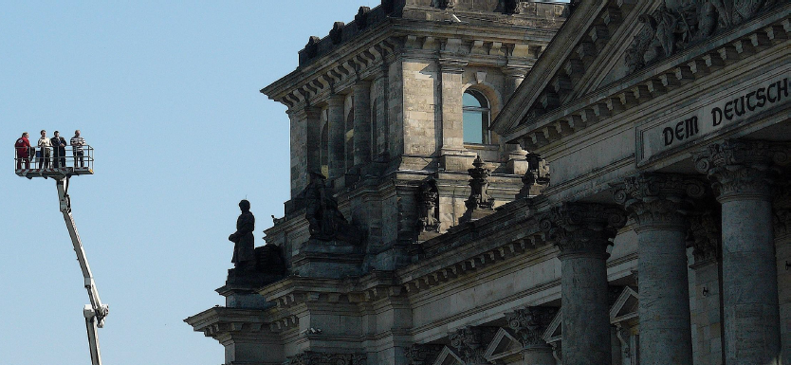
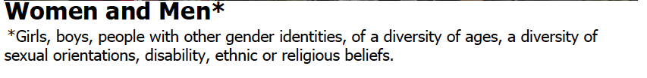
A Vision of Equality – The Mission Statement
Notes:
Germany’s constitution has asserted the equity of men and women for 65 years. To help reality catch up with the law, the constitution was amended 20 years ago obligating the State to enforce the actual equality of women and men.
The state of Berlin has already done a lot towards this end. It has worked to promote equal opportunity on the employment market and to protect women and children from domestic violence. It has passed the State Gender Equality Act and promoted women’s initiatives. Yet a policy to improve gender equality can only be truly successful if all bodies of government in both the districts and the Senate administration act in concert.
For numerous people and agencies to work together on the same task, they need a common basic understanding. That is why, drawing on experiences with the GPR, the idea arose to develop a joint mission statement on gender equality in the state of Berlin. It outlines what life in an ideal, gender-equitable Berlin would look like and serves as a guide for the government’s actions related to all spheres of life, including employment, family, and culture.
The mission statement formulates a ideal vision of gender politics from the perspective of citizens.

Slide 12
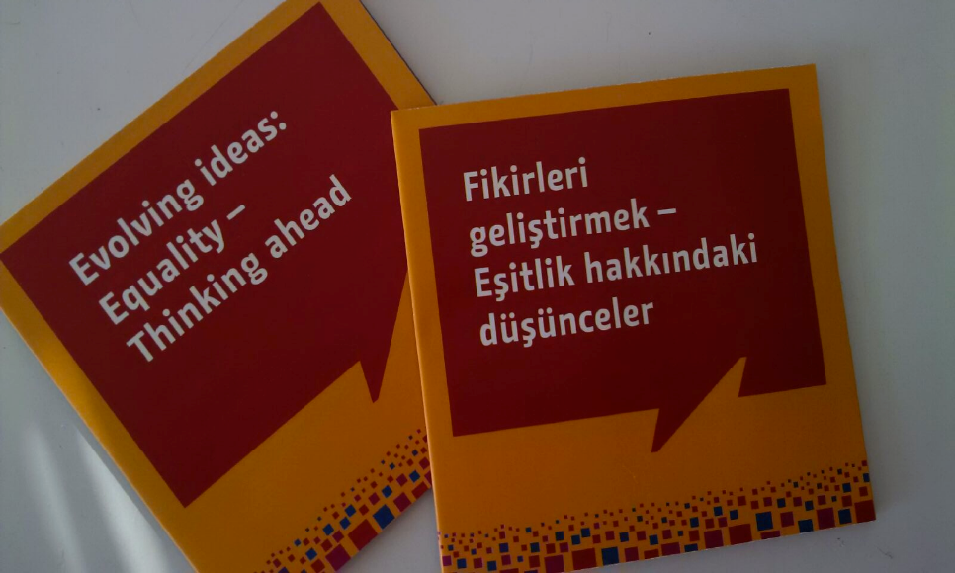
Notes:
We offer this booklet in by now seven languages
I will now present the different parts of the Mission statement.
As you can see by the asterisk above, our mission statement has a footnote at the beginning. We know, that gender drastically shapes the reality of people‘s life. We know that other factors such as age or sexual orientation are similarly powerful. These factors structure the opportunities and realities of people.

Slide 13
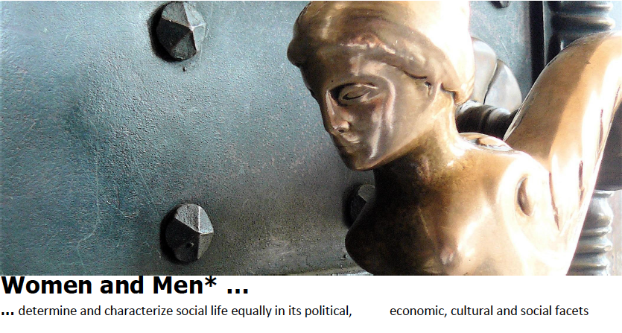
Notes:
The individual passages of the mission statement apply to all ministries.
Looking at the public space, we may ask: Who makes an impression about in? Who is able, to imprint this themselves?
The grasp o power at this town hall obviously had females in the palm of their hand. That is symbolic dominion at its best.

Slide 14
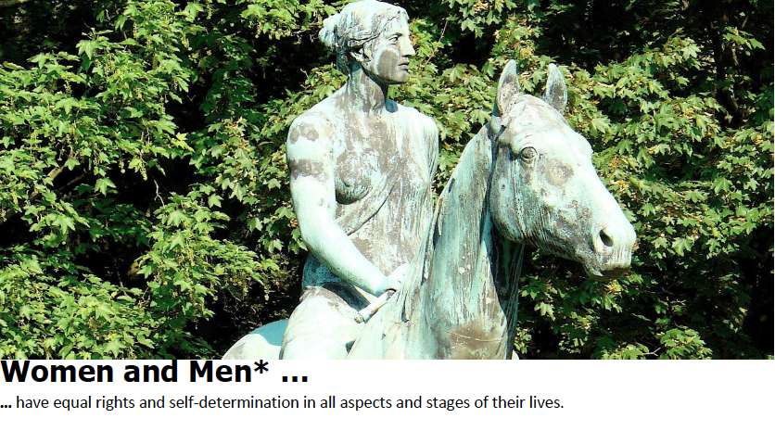
Notes:
Self determination it at the heart of equality.
Who looks? Who rules? Who is the object?
Who ducks away and conceals themselves?
Who is loud and take over space?
Does gender influence the way a room is designed?
This Amazon at the Berlin Tiergarten acts as a topology for both genders

Slide 15
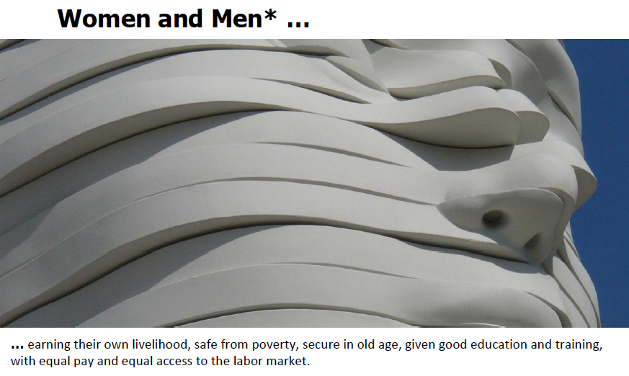
Notes:
Being able to take care for oneself, to earn your own money and be well protected in old age, is the basis for a self-determined life. That means to have the ability to define your own place in life.
For women, these are still fairly new options. Out tax- and social security systems for example are still shaped by the ideal of a male breadwinner.

Slide 16
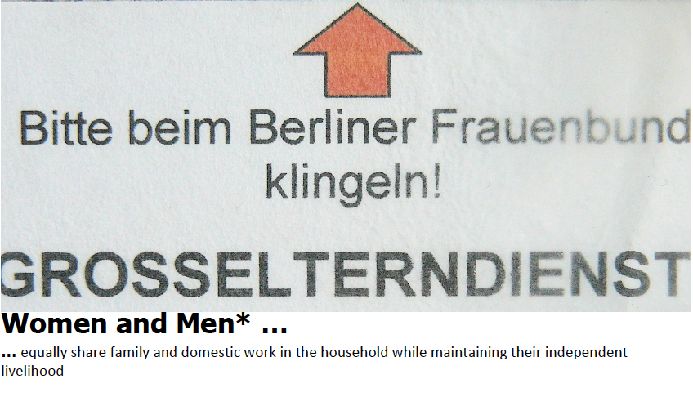
Notes:
Gender relations are changing. This applies to the question, who is responsible for domestic work, in child care, care for the elderly, and the care of the sick. Maybe even for the care of a good living.
Domestic work is the invisible side of the economy, done by women. Where women start to work on their own, domestic and care work are pushed on the street: Evermore public facilities are required.

Slide 17
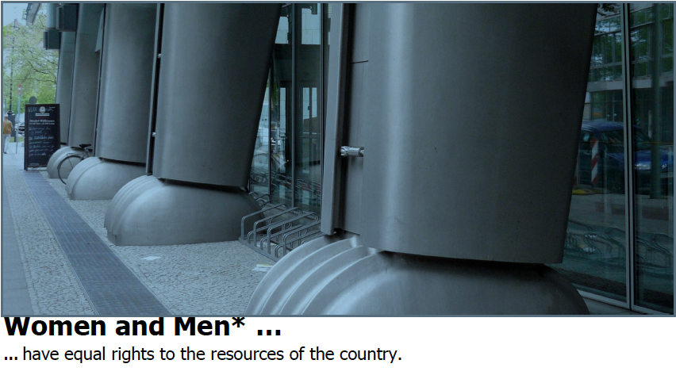
Notes:
Who gets what? And how much?
Public funds bless one hand while neglecting the other. Whoever wants to create justice must start with the budgeting of gender.

Slide 18
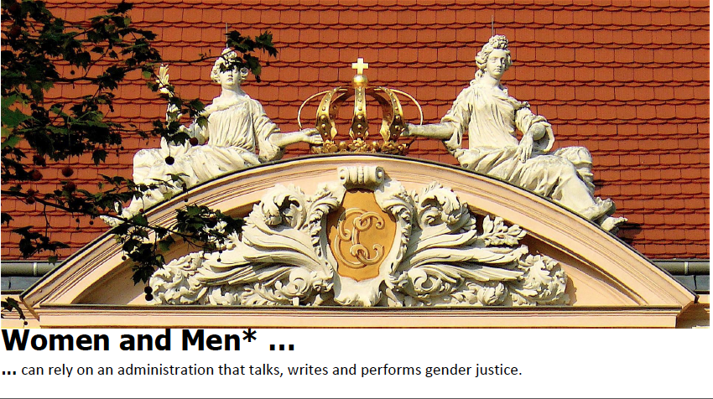
Notes:
A citizien orientated management is on everyone‘s lips. Hopefully the female citiziens are also included. This applies to the language and the response to it: the internal images that language create.

Slide 19

… learn and teach in a gender-equitable way in schools, day care centers, and all other educational facilities.
Notes:
Education is at the centre of all discussions of equality. The opening up of the education to girls has been profitable: in school and in study they have been able to attain better qualifications. But that‘s only half of the story. Bodies of knowledge remain gender relational as girls are still underrepresented in advanced fields. For boys, learning is something not meant for men. The site of learning must be atractive for both sexes.

Slide 20
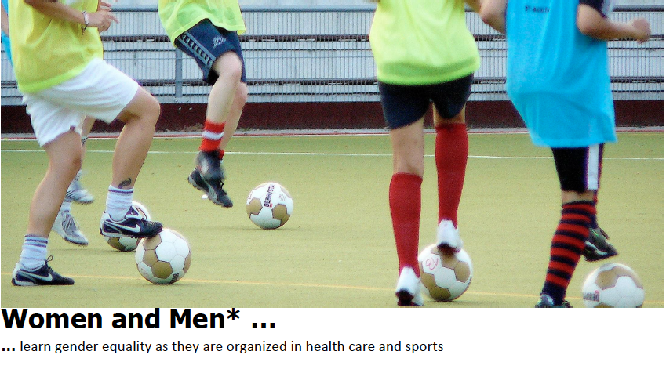
Notes:
Nowhere else does the division of public space become so apparent as it does during sports and games. Soccer fields, football fields, park meadow, half pipes, GMX systems all afford boys and men plenty of space. Through official and unofficial means – and somewhat intimidating strategies – girls and women are too often successfully excluded.

Slide 21
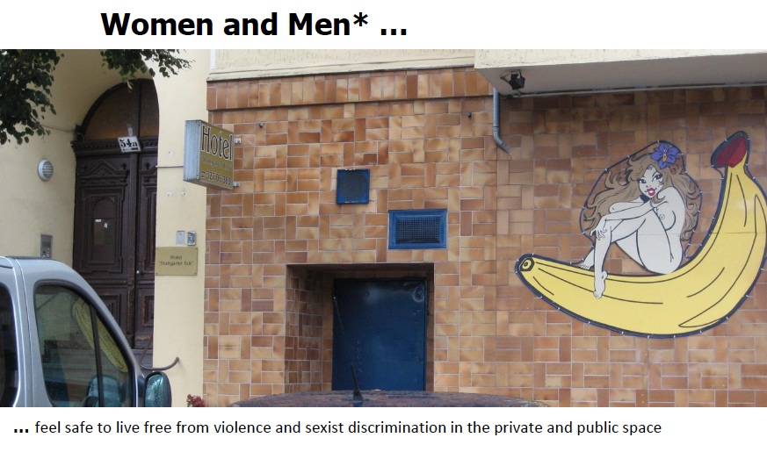
Notes:
Fear is not a good companion. Intimidation, assaults, insults, violence: Fear mongers are many and can develop places and times that are no-go zones for some groups. An anti-racist initiative is as important as an anti-sexist one. Social and symbolic structures contribute to either anxiety and deterrence or well-beeing.

Slide 22
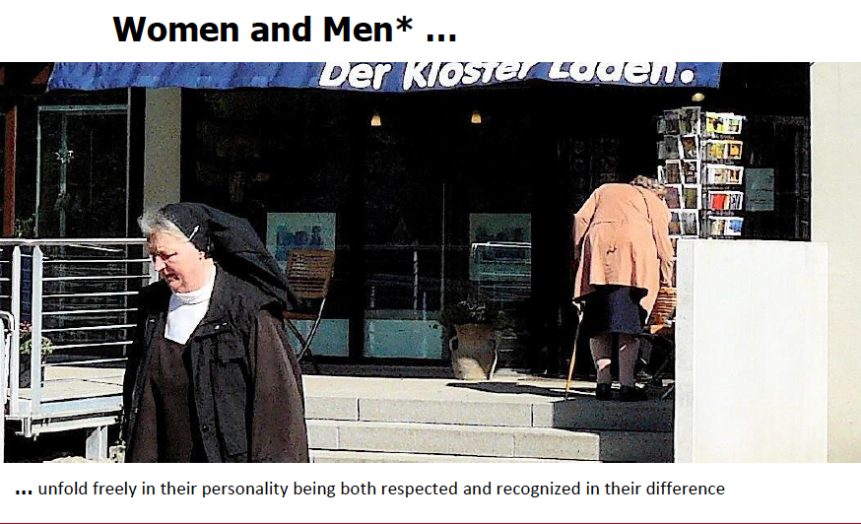
Notes:
Diversity is the reality in the city. The recognition of diversity means abandoning traditional domination and it‘s mechanisms of exclusion. The challenge is immense: Any form of Lobbying is to be forestalled; the outspoken als well as the retincent are to be listenend to.
This is the last sequence of our mission statement.
To finish my talk, I would like to give you some impressions and thoughts about what this could mean while considering a women friendly City.

Slide 23
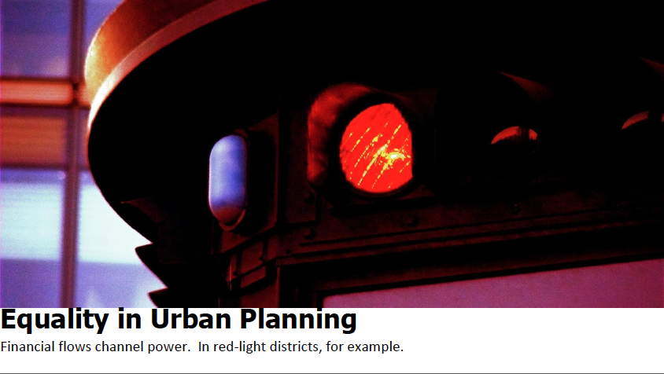
Notes:
In urban living, many interests intersect – the economic influence is one of the most important intersections. Herein lies a more abstract form of the challenge: extremely mono-sex decision making power over financial and capital flows which produce an effective and powerful gender imbalance.

Slide 24
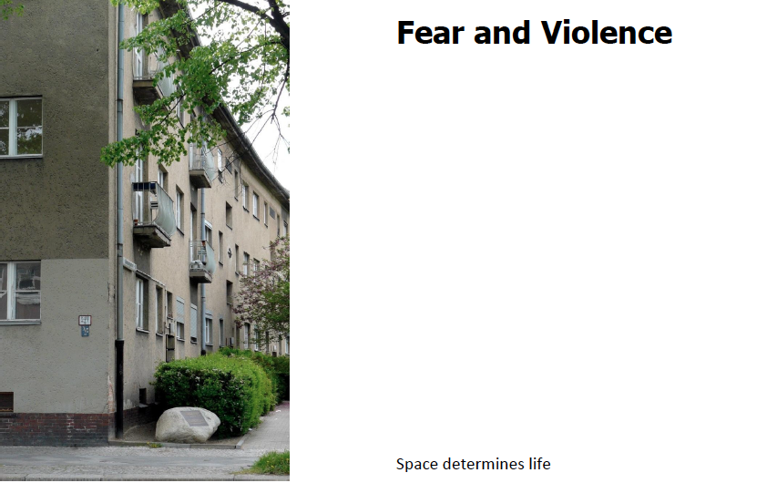
Notes:
A young Turkish woman was murdered by her brother in the corner house. The stone remembers her. Races of the city also bear witness to the violence which groups and individual ideas of life impose upon its members. The space communicates violence. Violence against women takes place mainly in the interior, within the family inside the house. Girls and women learn to explore perspectives of avoiding violence from the public space.

Slide 25
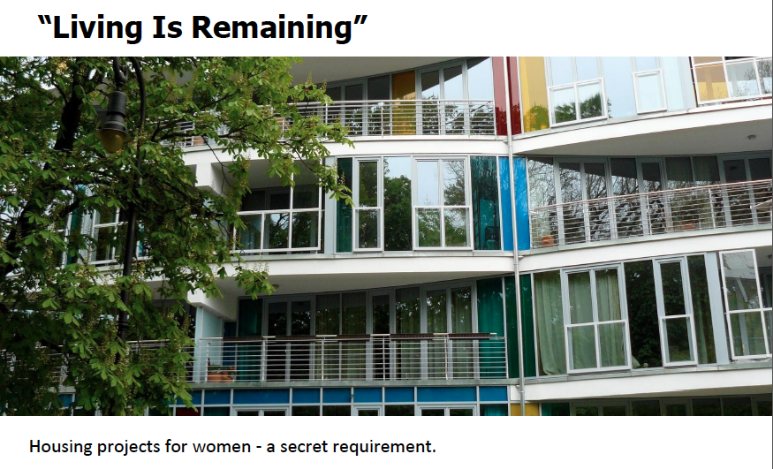
Notes:
Projects for women dwelling play a relatively small role in residential planning. Hitherto, experience with those projects that have received no public funds and are realized by personal activism, revealed a niche in the building sector: A community of women, that is open to men, meets the need of many, especially older women.

Slide 26
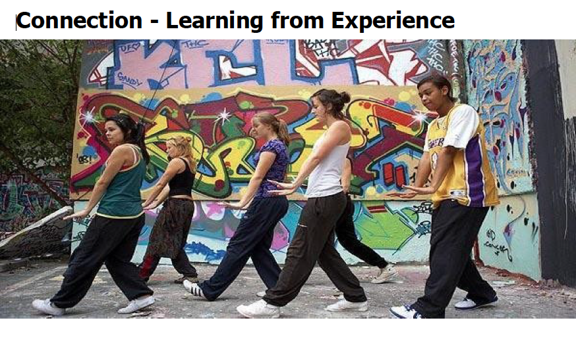
Notes:
Diversity, equal opportunities, gender equality, gender Mainstreaming, mission statement – the approach to a gender equality plan has precursors. There are theoretically and practically proven approaches to women-orientated, women-specific and feminist ideas of a women friendly city. They have taught us to see the ostensibly gender-neutral blind spots in politics and administration.

Slide 27

Thank you very much for your attention!
The photos for this presentation were taken from the book „Spree Pearls. Berlin – City of Women“, which has been published by some colleagues and me in 2011. Kerstin Grune took them.
The illustrations belong to the memory-game “Turning heads” which has been developed by me together with the illustrator Nadia Budde as part of our campaign „Thinking equality ahead!“

